Slide 1
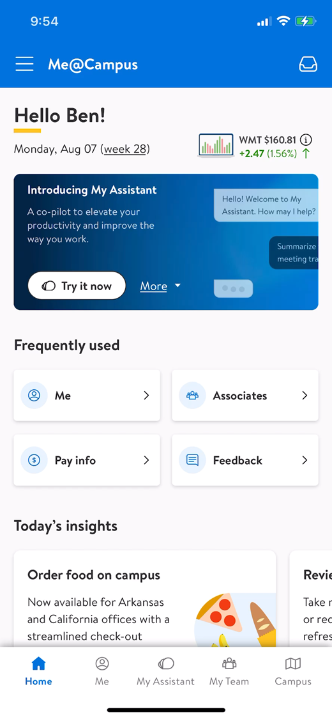
Get Moving with My Assistant
Fall/Winter 2023
Notes:
Presenters:
Be sure to add your use cases and specific examples for your learners!

Slide 2
Learning Pathway Components
Unlock Business Potential
Grow Your Skills
Invest Long Term
Take ownership of your organization’s adoption:
In-person immersion tailored to your function
Immersion graduates will lead the immersion deeper into their organization
AI-assisted learning “workouts” in My Assistant:
Intermediate Prompting with Functional Examples
Find one way to use it every day
Upskilling tracks will emerge for specific business roles:
Ex: Advanced Prompting
Ex: Content Management for Gen AI
Coming Later!
*International markets and Sourcing will receive translated materials.
Notes:
Welcome to our session! You’re on a path to immerse yourself in GenAI. There’s much more to come in the days and weeks to follow, but here’s a brief overview of the learning pathway.
In Grow Your Skills, we’ll be introducing fun and bite-sized learning opportunities in My Assistant to get you used to using the tool every day.
In Unlock Business Potential we will take teams within a functional area through a facilitated immersion, which is a more personalized course helping teams ideate and get started with their own use cases. In fact, that’s what we’re doing today.
And once you complete today’s immersion and become certified, you will be equipped to help facilitate the immersion deeper within your organizations. On the heels on that, we are thinking long-term and expect more niche tracks to emerge.
Now a quick note for those of you that are already advanced users in GenAI. Don’t worry! We understand you may already be using this every day. We won’t spend a long time in the mechanics. We know the value for you is going to come through our discussions and the Brainstorm Bash. We’re glad you’re here to share your expertise with us.
So really quick, let’s take a short survey.

Slide 3
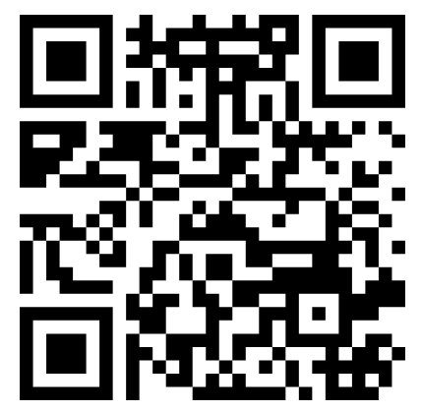
Pre-Survey
Notes:
It’s just a few questions and your answers will help us refine these sessions for the groups that follow.
(Share the QR code for Mentimeter and walk them through each question and live results. The producer will switch screens to the Mentimeter presentation.)
The questions on the Mentimeter are as follows:
What are one or two words to describe how you are feeling about GenAI right now?
Have you used My Assistant for your work since it was launched on July 31st?
How have you used My Assistant?

Slide 4
Agenda
Gen AI / My Assistant Overview
Prompting
Brainstorm Bash
Use it, share it, expand it!
Notes:
So today we start with a look at our tools. What is My Assistant and what else is on the horizon?
Next, what are the rules to keep us safe? What’s okay and what’s not?
Then to the finer points of prompting. How do we make My Assistant work for us and how do we craft effective, purposeful prompts?
Next, we go to work trying out the tools and seeing how they fit into our work routines in our Brainstorm Bash.
And finally, how do we share this new way of working so it continues to grow and expand to fit our needs? You will be certified after today. How will you help others follow their own path to do the same?
Sound fair?

Slide 5
GenAI
Is
Is not
a tool.
an enhancement.
a seismic shift.
a replacement for people.
perfect.
Notes:
Gen AI and our tool, My Assistant, can do amazing things.
First, it’s (click) a tool similar to others we use every day like Workday or Microsoft Outlook.
It’s also (click) an enhancement to what we can already do, not just another app in our store.
And really (click), it’s a seismic shift for productivity.
It can summarize long articles into a few bullet points and give that time back to you for other things.
It can create an outline for a presentation, much like this one, and let you concentrate on making it stick with your end users.
It does the things that are mundane and repetitive and is totally okay with doing them every day without getting bored.
But with change can come fear, so be sure to share with your teams that Gen AI is not (click) a replacement for people or good judgment. Just because the tool can create something doesn’t mean that it’s right or good or in keeping with our values. We need people to read and respond to things created with Gen AI and give them the dimensions of empathy and emotion.
And Gen AI is not (click) perfect. It makes mistakes. It “hallucinates” and gives wrong answers. (share a funny story about hallucination.) It’s our job to validate the things it creates and apply them to our business in a way that is responsible to us and our customers and members.
Fair enough? Ready to dive in?

Slide 6
Where to find My Assistant
From your smartphone, access Me@Campus from the Apple App Store or Google Play by scanning the QR codes.
Or visit https://campus.walmart.com/ for the desktop experience.
Notes:
Alright, let’s get started. Capture the QR code for your type of device or use your laptop to go to campus.walmart.com. You will need to be on the VPN (on Eagle).

Slide 7
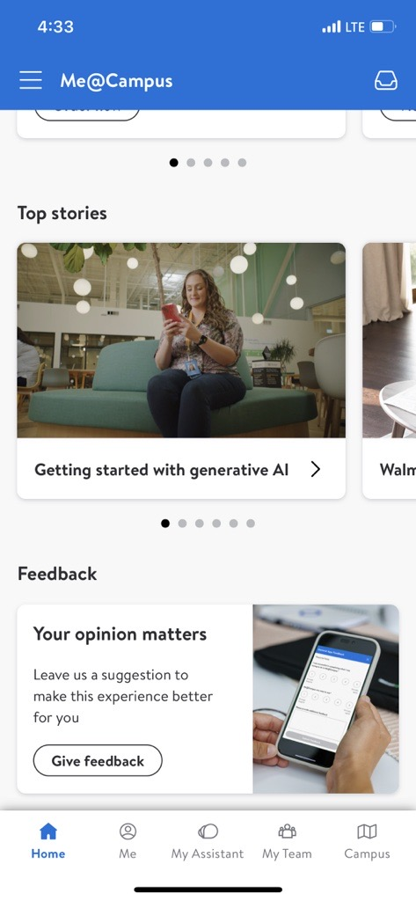
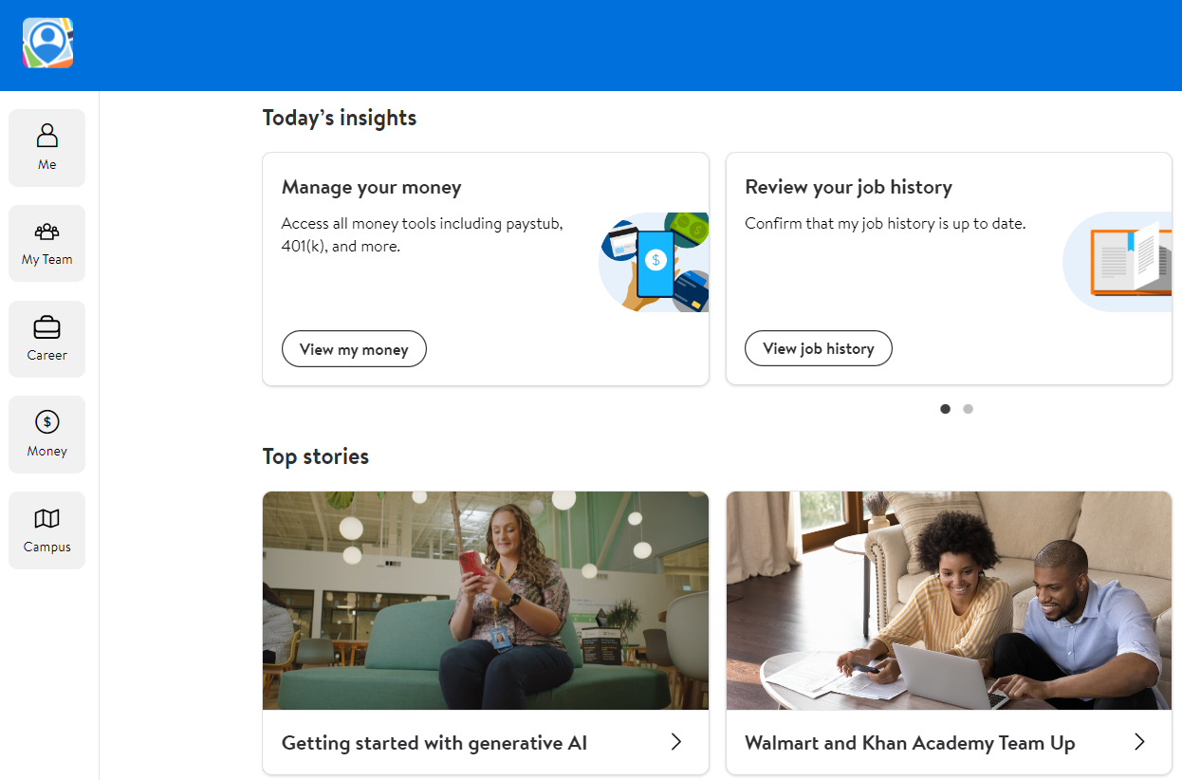
7
Notes:
Everyone there?
Our new tool is My Assistant. It lives on the Me@Campus page or in your Me@Campus app on your device.
It can be used with some Walmart proprietary information, and it continues to learn every day.

Slide 8
Data Sensitivity
Do NOT include or share PII anywhere.
​
In My Assistant:​
Non-sensitive/Sensitive = Yes​
Highly sensitive = NO​
In open apps:​
Non-sensitive = Yes, and NO​
Sensitive/highly sensitive = NO
Notes:
Before we jump in, let's talk about the rules to keep our data safe.
My Assistant is our private tool, but it is available to all U.S. campus associates across the enterprise. You should never include PII (personally identifiable information) in your questions. Beyond that, you have to handle data sensitivity at each level.
Non-sensitive (publicly available) information can be used in our proprietary tools and the ones open to everyone on the web like ChatGPT, Bard, or Perplexity. HOWEVER, there is a caveat on the ‘publicly available information’ – if it’s for work use, it should be in My Assistant. The prompts that go into that go back to training their models. So, even though it may not directly be giving away proprietary info, the prompt still might be giving away at least the knowledge that Walmart cares about a certain topic depending on how the prompt is written.
Anything that is considered sensitive may only be used in our closed GenAI systems like My Assistant. (Give an example from your area.)
And anything highly sensitive should NOT be used in any GenAI tool yet, outside of a private, internal sandboxed environment created specifically for your use case. (Give an example from your area.)
Does that make sense? Let’s consider some examples.
Would you prompt the public GenAI about sustainability at Walmart?
Yes, that would be fine as long as the information has already been shared publicly.
What about the store management recruiting process?
No, only information that has been shared publicly.
How will you handle intellectual property?
Consult legal with any questions on what constitutes intellectual property.
When in doubt, review the guidelines and/or consult the legal team.

Slide 9
Real World Use Cases
Try one of these three prompts:​
​
1. Write a summary of Walmart's core beliefs to be used in an orientation session with new associates.
​
2. Write an email to managers to prepare for talent planning.
​
3. Read Walmart's sustainability report and give a summary of the key takeaways.
Notes:
Okay, let’s jump in. You already know the basics of conversational prompting. Ask My Assistant to complete one of the tasks you see on the screen.
(Give them a few minutes to try it out.)
How are we doing? Are you getting some good results?
All those prompts probably returned some general answers, which can be helpful. But to get the most use from the tool you need to go deeper. Specific prompts return specific results.
1. Write a summary of Walmart's core beliefs to be used in an orientation session with new associates.
​
2. Write an email to managers to prepare for talent planning.
​
3. Read Walmart's sustainability report and give a summary of the key takeaways.

Slide 10
Prompting: A Formula
Role – Task – Instructions – Example/Data
You are a [role]. Create a brief, friendly email that summarizes the [information or policy]. Be sure to emphasize [component]. Use this information: [text of information] or [link to policy].
Notes:
Let's try a prompting formula. It is role (context) + task + instructions + examples or data.
Start by telling My Assistant what role to play or describe the situation. “You are a People partner” or “You are a product owner in x area” or “I am having trouble remembering to follow up on action items from meetings.”
Next tell it specifically what you want it to do or create, maybe a letter, table, checklist, or set of questions.
Then give it detailed instructions. “I need the results to adhere to our Walmart values and culture.”
Finally, give it data or examples to make it more concise. Provide a sample of your writing, an article, or a social media post, etc. You can copy and paste it in or provide a link to the internal page. The tool does NOT have access to the public internet so keep that in mind.

Slide 11
Improving the Prompt
Role – Task – Instructions – Example/Data
Real World Use Cases
You are a [role]. Create a brief, friendly email that summarizes the [information or policy]. Be sure to emphasize [component]. Use this information: [text of information] or [link to policy].
1. Write a summary of Walmart's core beliefs to be used in an orientation session with new associates.​
2. Write an email to managers to prepare for talent planning.​
Notes:
Now go back to one of the prompts you tried previously and try asking again with the new formula. For example, try “You are a People Manager. Create an email to managers to prepare for talent planning. Focus on development planning and include three action items for the session. Use the following as reference: (then paste in the reference material.)
What's different about the results? Are they better this time?
And if you aren't happy with the results, ask follow-up questions or give it another task. You can say things like "can you make this simpler?" or "please make this shorter.” or “make this more conversational." The tool remembers what you asked and can follow the conversation - usually. If the tool happens to forget or get confused, you can always start over. It has a working memory that lasts around 30 minutes.
NOTE: Don’t forget about hallucinations! Our four core values are Respect for the Individual, Service to the Customer, Strive for Excellence, and Act with Integrity. Did you get those in your results? How will you validate the results? You are accountable no matter where the information comes from.
One more note about prompting – you can have the tool ask you questions. For example, let’s say you get a result, but you feel like it could be more helpful. Prompt the AI to interview you. Try “Please ask me questions to provide you with more information you might need for a better result.” Give it a try.

Slide 12
Brainstorm Bash: Let’s Get Moving!
Break into groups of 2-4. ​
Brainstorm ideas for using Gen AI in your role.
Determine the highest level of data sensitivity required. ​
Notes:
Okay, so we now know how to create some strong prompts. Are you ready to apply this to your day?
Break into groups of 2-4.
Brainstorm ideas for using Gen AI to make your day-to-day more productive.
-What tasks can Gen AI do for you? What communications could it write? What data could it help analyze? What do you do daily that is repetitive that it could take off your plate? Remember, it won't get bored!
Determine the highest level of data sensitivity that would be required for your use cases – public, sensitive, or highly-sensitive.
We'll come back together and bucket the use cases and data as a group.
We’re not saying it’s a competition…but….make sure you have someone to represent your area.
Looking for volume
Think big and small – think about things that you can start immediately
You have 25 minutes. (Adjust as needed.)
What questions do you have?
If the teams are struggling, be ready to provide examples, exercises, and use cases to get them started.

Slide 13
Prompting: The formula
Role – Task – Instructions – Example/Data
You are a [role]. Create a brief, friendly email that summarizes the [information or policy]. Be sure to emphasize [component]. Use this information: [text of information] or [link to policy].
Notes:
(After the groups settle in, share this slide for reference while they work.)

Slide 14
Debrief
What did you learn?
Notes:
Bring everyone back to debrief. Ask:
What did you learn?
Who has great examples to share?
What did NOT work, and how could we fix that?
Remind them to be brave and fail fast!
If time allows, go a step further. What did they find that requires sensitive or highly sensitive data? How could we use the tool to augment the work without exposing data? What options can they think up?

Slide 15
Cascade Plan: Use it, share it, expand it!
Notes:
So, now you know what GenAI is, what tools we have to use, and how to create specific prompts to return specific results.
Email your lists to me before you leave today. We will store them centrally to synthesize and build on over time. And for additional cascade sessions, we’ll ask that you store additional brainstorm lists here: Get Moving with My Assistant - Idea Repository
What do you need from us to be ready to share this information with your teams (cascade)?
We will provide you with a copy of this presentation and a facilitator guide.
How else can we help?
Cascade contacts on next slide

Slide 16
Cascade Support
Evelyn Barnes
Caleb Dover
Courtney Naudo
Isabel Cruz
Judy Werthauser
Kim Lupo
Denise Malloy-Deaderick
Amy Goldfinger
Christopher Shryock
Lo Stomski
Vicky Dodson
Ben Peterson
Notes:
(Hide this slide if not relevant to your group/situation.)
Each org will be paired with Evelyn or Caleb to produce a cascade session within your organizations.
One of them will reach out to these respective leaders to align on who from the leadership should own the cascade session (could be all or a subset)

Slide 17
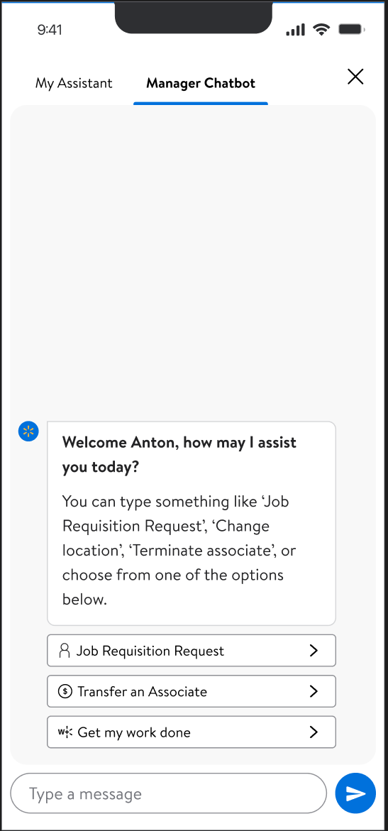
Key Takeaways
Determine how you take this knowledge and cascade it down and across through your organization.
1
2
Try to find one way every day to use My Assistant to make you more productive.
3
ALWAYS validate results. You are responsible for the use and accuracy of your prompts and outputs.
Notes:
As we close today’s meeting, I just want to reiterate how exciting it is to be part of Walmart during this seismic tech shift.
Me@Campus and My Assistant will help augment your work like never before. Take advantage of these new efficiencies!
So, what comes next in the tool? We already added the Manager Chatbot next to My Assistant to streamline the way you work. Now you can complete those processes right from the same screen.
We’re finding new ways to improve the tool every day and getting ideas from everywhere. Have a great idea? Share it with us!
We know you’ll have questions. Send those questions and any feedback to the Me@Campus team.
Our ask – for any new builds you are interested in, your People Product partner should be involved and both you and your product partner should be coordinating with Alisea Blower and Mackenzi Crank.
Donna is the executive sponsor for our GenAI roadmap in Global People. And Ben Peterson and Mackenzi Crank are accountable for communicating the roadmap to the Executive Steering Committee, who is accountable for sharing with Doug and EC members.

Slide 18
Certification
Notes:
Now that you've completed the work it's time to get certified.
(Me@campus screenshot that shows the learning and how to complete the acknowledgement.)
https://moodle-azure.prod.walmart.com/moodle/course/view.php?id=20434

Slide 19
How are you feeling about GenAI right now?
Notes:
Let’s take another quick survey to see how you're feeling about GenAI now.
(Give them a few minutes to complete the survey and share the word cloud.)

Slide 20
Where we started
Where we are now

Slide 21
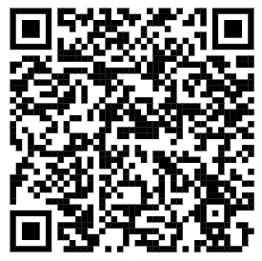
Post-Survey
Notes:
Let’s take another quick survey. It’s just a few questions and your answers will help us refine these sessions for the groups that follow. https://feedbackally.walmart.com/survey/P7zwKdPFTK42dGL

Slide 22
Helpful Links
Me@Campus | campus.walmart.com
GenAI Resource Site | wmlink/gen-ai
Data Classification Policy | Policy Link
GenAI Usage Guidelines | Guidance Link
Notes:
Here are some helpful links. They will be shared with you in the follow-up email, and they are on the GenAI site.

Slide 23
Thank you!
Notes:
Thank them and encourage them to visit the GenAI pages on OneWalmart.

